Slide 1
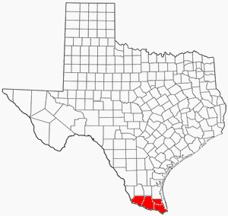
Presenter:
Irasema Garcia, Partnership Specialist
U.S. Census Bureau-Denver Region
956-572-1009
irasema.garcia@2020census.gov
Notes:
Good morning. Thank you for the opportunity to speak with you today to give you an update on the 2020 Census for the RGV.
Introduce Marta Ortiz and share contact information. Marta.g.ortiz@@2020census.gov, cell

Slide 2
Why We Do a Census?
Article 1, Section 2 of the US Constitution
The actual enumeration shall be made within three years after the first meeting of the Congress of the United States, and within every subsequent term of ten years, in such manner as they shall by law direct.
Notes:
Ask the audience, “Why do we do the Census?”
Bottom line it is mandated by the Constitution, so it is required.
Does anyone know what year we did the first Census? (1790).
Anyone know what day Census day is? (April 1). The Census is a snapshot of where all individuals who reside in the US live on that specific day.

Slide 3
The Decennial Census
Conduct a census of population and housing Disseminate results to the President, the states and the American people
Uses of census data:
Apportion representation among states
Draw congressional and state legislative districts, school districts and voting precincts
Enforce voting rights and civil rights legislation
Distribute federal dollars to states
Inform planning decisions of federal, tribal, state and local government
Inform organizational decisions (e.g., where to locate, size of market, etc.) of businesses and non-profits
Notes:
2,054,746,
Counting for Dollars 2020
16 Large Federal Assistance Programs that Distribute Funds on Basis of Decennial Census-derived Statistics (Fiscal Year 2015)
Montana
Total Program Obligations: $$43,334,650,874, $1578 per capita
Per Capita: $1,989 (see note on proper use) CFDA #
Counting for Dollars 2020: The Role of the Decennial Census in the Geographic Distribution of Federal Funds ,
Additional data uses include:
To draw congressional and state legislative districts, school districts and voting precincts by states, tribes, and local governments
To enforce voting rights and civil rights legislation by the Department of Justice
To distribute more than 400 billion dollars EACH YEAR in federal funding for than 1,000 programs administered by 26 federal agencies to tribal, state, and local governments. Census population figures form the basis for the allocation of significant amounts of federal funding. Missing a housing unit, and the associated population, during the decennial census may result in a missed opportunity for governments to benefit, which perpetuates until the next decennial census.
To inform the decisions of governments, businesses and non-profits regarding community and regional development, education, agriculture, energy, and environmental programs, as well as other community improvements and enhancements. Census data informs communities so they may allocate their own funding for neighborhood improvements, public health, education, transportation and much more.

Slide 4
FUNDING
$675 BILLION FEDERAL FUNDING
ANNUALLY

Slide 5
Largest Programs Using Census Bureau Data to Distribute Funds
Program Name | Federal Executive Department or Agency | Fiscal Year 2015 Funds
Medical Assistance Program | HHS | $311,805,244,413
SNAP | USDA | $71,035,786,000
Medicare Part B Physicians Fee Schedule Services | HHS | $70,300,000,000
Highway Planning and Construction | DOT | $38,479,013,855
Federal Pell Grant Program | ED | $29,916,694,438
National School Lunch Program | USDA | $18,915,944,292
Temporary Assistance for Needy Families | HHS | $17,225,738,021
Program Name | Federal Executive Department or Agency | Fiscal Year 2015 Funds
Section 8 Housing Choice Voucher | HUD | $15,761,488,440
Title 1 Grants to Local Educational Agencies | ED | $14,253,154,251
Special Education Grants to States | ED | $11,382,885,850
Head Start | HHS | $8,538,887,781
Special Supplemental Nutrition Program for Women, Infants, and Children | USDA | $6,062,899,861
Federal Transit Formula Grants | DOT | $5,452,882,796
Foster Care Title IV-E | HHS | $5,409,221,818

Slide 6
Largest Programs Using Census Bureau Data to Distribute Funds
Program Name | Federal Executive Department or Agency | Fiscal Year 2015 Funds
Child Care Mandatory and Matching Funds of the Child Care and Development Fund | HHS | $5,314,103,129
Section 8 Housing Assistance Payments Program | HUD | $4,367,081,456
State Children's Health Insurance Program | HHS | $4,212,457,713
School Breakfast Program | USDA | $4,057,189,000
Low-Income Home Energy Assistance | HHS | $3,387,315,199
Hurricane Sandy CDB Grant Disaster Recovery Grants | HUD | $3,347,522,549

Slide 7
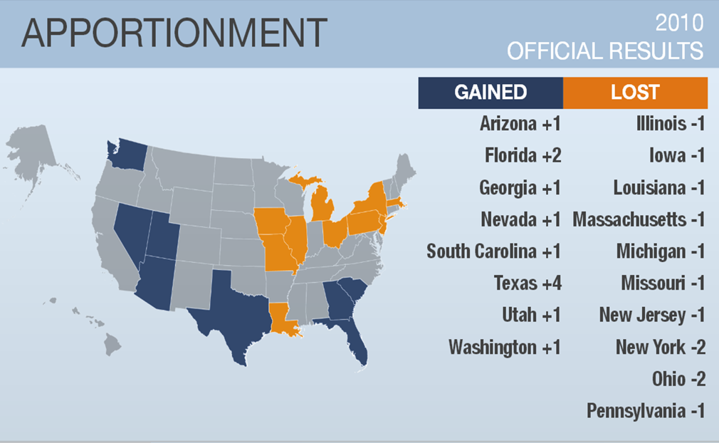
Representation

Slide 8
Confidentiality
The Census is confidential and required by law
All responses to Census Bureau surveys and censuses are confidential and protected under Title 13 of the U.S. Code
The results from any census or survey are reported in statistical format only.
Notes:
Please share this message with the community. The census is confidential and we believe educating the community about this will increase response rates.
Confidentiality along with irregular housing, little or no knowledge of Engish, limited formal education, all make an area hard to count.

Slide 9
Confidentiality
Title 13, U.S. Code, all Census Bureau employees swear a lifetime oath to protect respondent data.
It is a felony for any Census Bureau employee to disclose any confidential census information during or after employment.
Penalty for wrongful disclosure is up to 5 years imprisonment and/or a fine of $250,000.
Notes:
Please share this message with the community. The census is confidential and we believe educating the community about this will increase response rates.
Confidentiality along with irregular housing, little or no knowledge of Engish, limited formal education, all make an area hard to count.

Slide 11
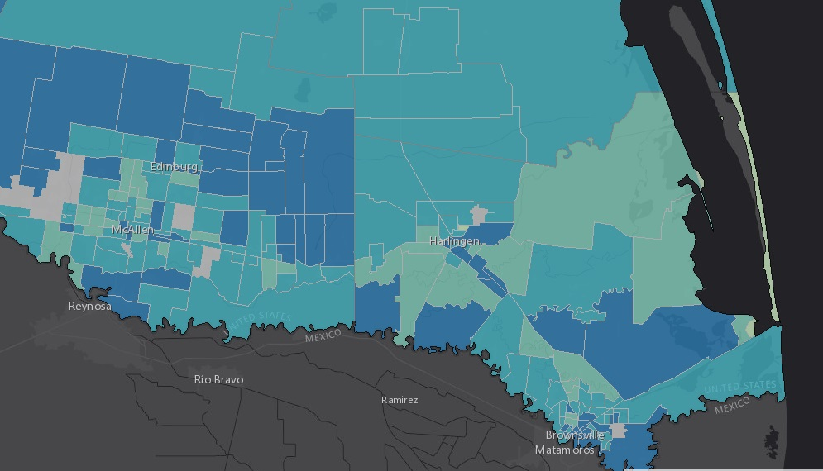

Slide 12
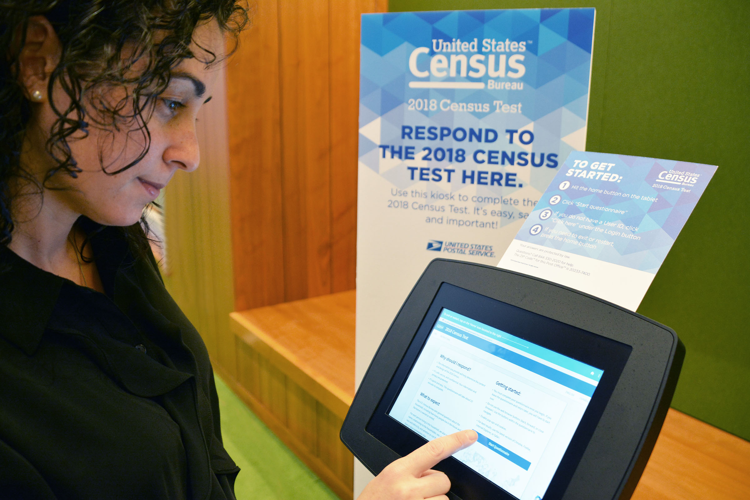
New Ability to Self Respond
Starting March 12, 2020
Internet
Phone
Paper Form
Last day to respond July 31, 2020
Notes:
Let’s move onto our second innovation area is OPTIMIZING SELF-RESPONSE.
In other words, how do we engage and motivate the public to respond?
The goal of optimizing self-response is to: generate the largest possible self-response, thereby reducing the number of households requiring follow-up.
In the 2020 Census we will be including the internet as a response option as well as the ability for someone to call our toll free number and give and interview over the phone. Both the internet and phone will be available in a number of different languages other than English and Spanish. Those that do not respond via the internet or live in an area with poor internet response will also be given the option to respond on paper. Everyone who does not self respond, we will visit in person and collect the information.

Slide 13
Invitation to Respond

Slide 14
How can organizations help?
Create a Census Complete Count committee
2 hr. Training
Census Embassadors
Monthly Meeting (8 months)
Invite Census to speak with staff/public

Slide 15
How can organizations help?
Share Census infomation and Census jobs in your location
Share Census information and Census jobs digitally (Facebook, Twitter, Youtube, Instagram, LinkedIn, Website, Email blast)

Slide 16
How can organizations help?
Be a response site (computer/tablet/kiosk/lab/phone)
Census reminder on bulletin/news/mailers
Host Census Day Event

Slide 17
How can organizations help?
Encourage participation
Allow Census presence at events
Cobrand

Slide 18
2020 Census
March 12 – July 31
April 1, 2020 Census Day

Slide 19
Resources
www.census.gov
Community Outreach Tool Kit
https://www.census.gov/partners/toolkit.pdf
Census on Social Media-YouTube, FB, Twitter, Instagram, LinkedIn
Media Tool Kit
Notes:
Census.gov-Examples: Quickfacts, ROAM, census careers, hard to count maps, Hidalgo County census page, partnership toolkit

Slide 21
Thank You
Irasema Garcia
irasema.garcia@2020census.gov
(956)572-1009

